Slide 1
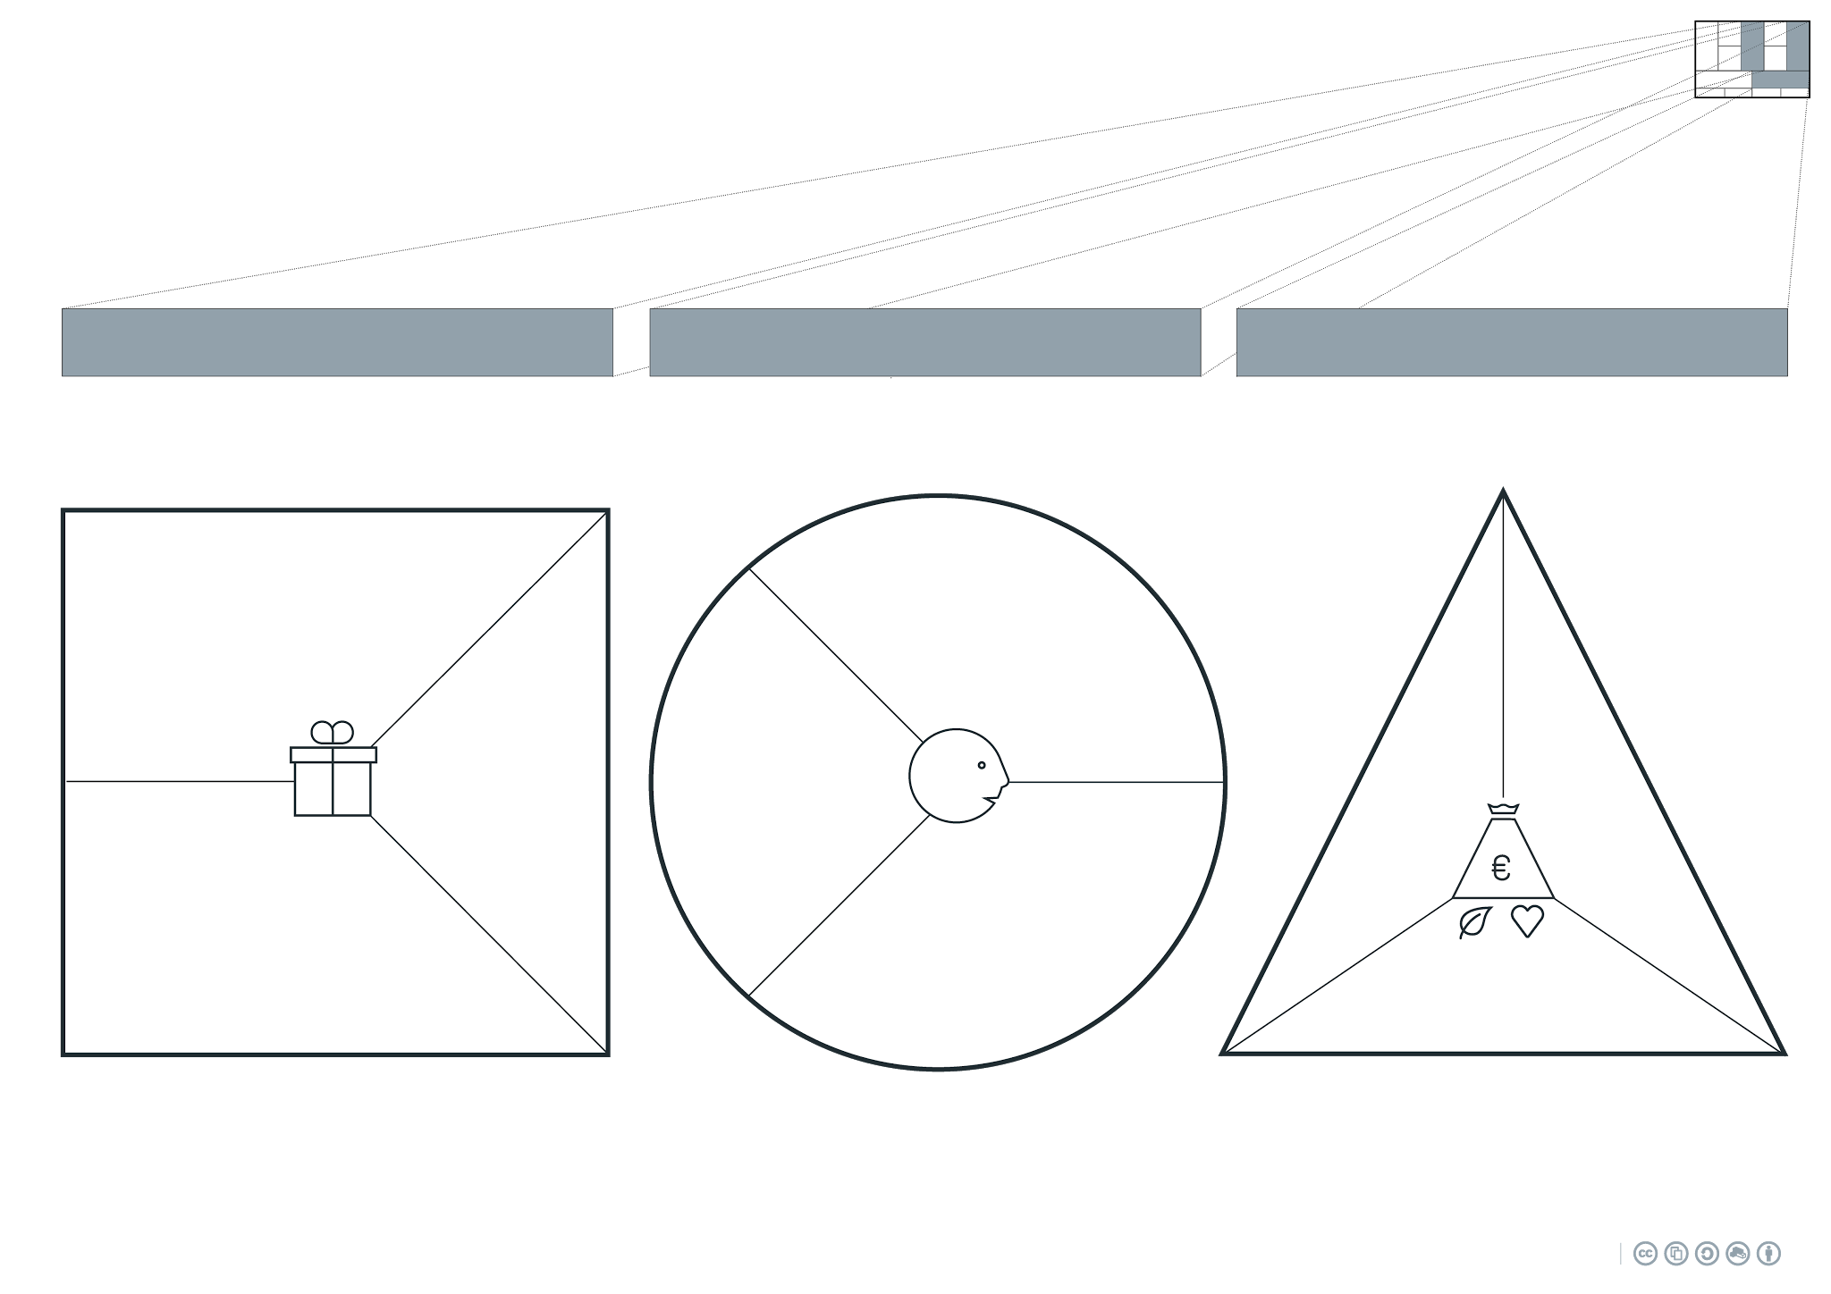
Which applications could we develop?
Which one of our customer’s problems are we helping to solve?
How does this compare to what your competitors offer?
What exactly are our customers paying for?
What value could we deliver to the customer?
For whom could we create value?
What characterizes these customer segments?
Who do we have a relationship with?
How could you generate revenue streams?
How do your competitors create revenues?
Applications:
What type of revenues are you aiming for? (money, customer access, data, time etc?)
⧠ Product
⧠ Service
⧠ Certification
⧠ Training
⧠ Maintenance
⧠ ...
Are we talking about an investment or about cash flow?
Which part of the value chain do you bring value to?
Revenue stream checklist:
Which different qualitative and quantitative added values can you distinguish?
⧠ Direct sales
⧠ In-kind
⧠ Donation
⧠ Subscription
⧠ Licensing
⧠ Advertising
⧠ Selling data
⧠ Success fee
⧠ Subsidy
⧠ Rent
⧠ ...
Customer segment checklist:
Added value checklist:
B2B
⧠ Sector
⧠ Position in value chain
⧠ Type of organisation
⧠ Location
⧠ Country
⧠ Customer base
⧠ Organizational structure
⧠ ...
B2C
⧠ Demographics
⧠ Generation
⧠ Behavior
⧠ Sex
⧠ Age
⧠ Lifestyle
⧠ Culture
⧠ ...
⧠ Newness
⧠ Performance
⧠ Customization
⧠ Ease of use
⧠ Design
⧠ Brand/Status
⧠ Price
⧠ Cost reduction
⧠ Risk reduction
⧠ Accessibility
⧠ Convenience
⧠ Profit maximization
⧠ Functionality
⧠ Aesthetic appeal
⧠ Emotional experience
⧠ Speed
⧠ Sustainability
⧠ Trust
⧠ Simplicity
⧠ Engagement
⧠ ...
Strategies like:
⧠ Freemium
⧠ One for one
⧠ Razorblade
⧠ No cure no pay
⧠ ...
Which strategies can you use to maximize revenues or make them more continuous?

Slide 2
That the product can be take apart and get back in to eachother in different look. Not much other designers has something like this in the market.
The customer pays for a lamp that can be use in different types.
Begin with advertisement and make every once in a while a new advertisement so the product stay in the picture of the client and new clients.
How are we gone find our customers?
What do our customers need to use our product?
...
In the begin you need to put money in the business but later you need to make money to continue with the business.
Applications:
Money to make the products, customers to sell the products and time to make the products.
⧠ Product
⧠ Service
⧠ Certification
⧠ Training
⧠ Maintenance
⧠ ...
...
...
Advertising
Use social media
Talk in your area about the product
Report all your data so you can see what Is going well and what is going less.
Location
With country
Customer bases?
Make enough advertisement and have enough products in your storage, not too much and not to less.

Slide 3
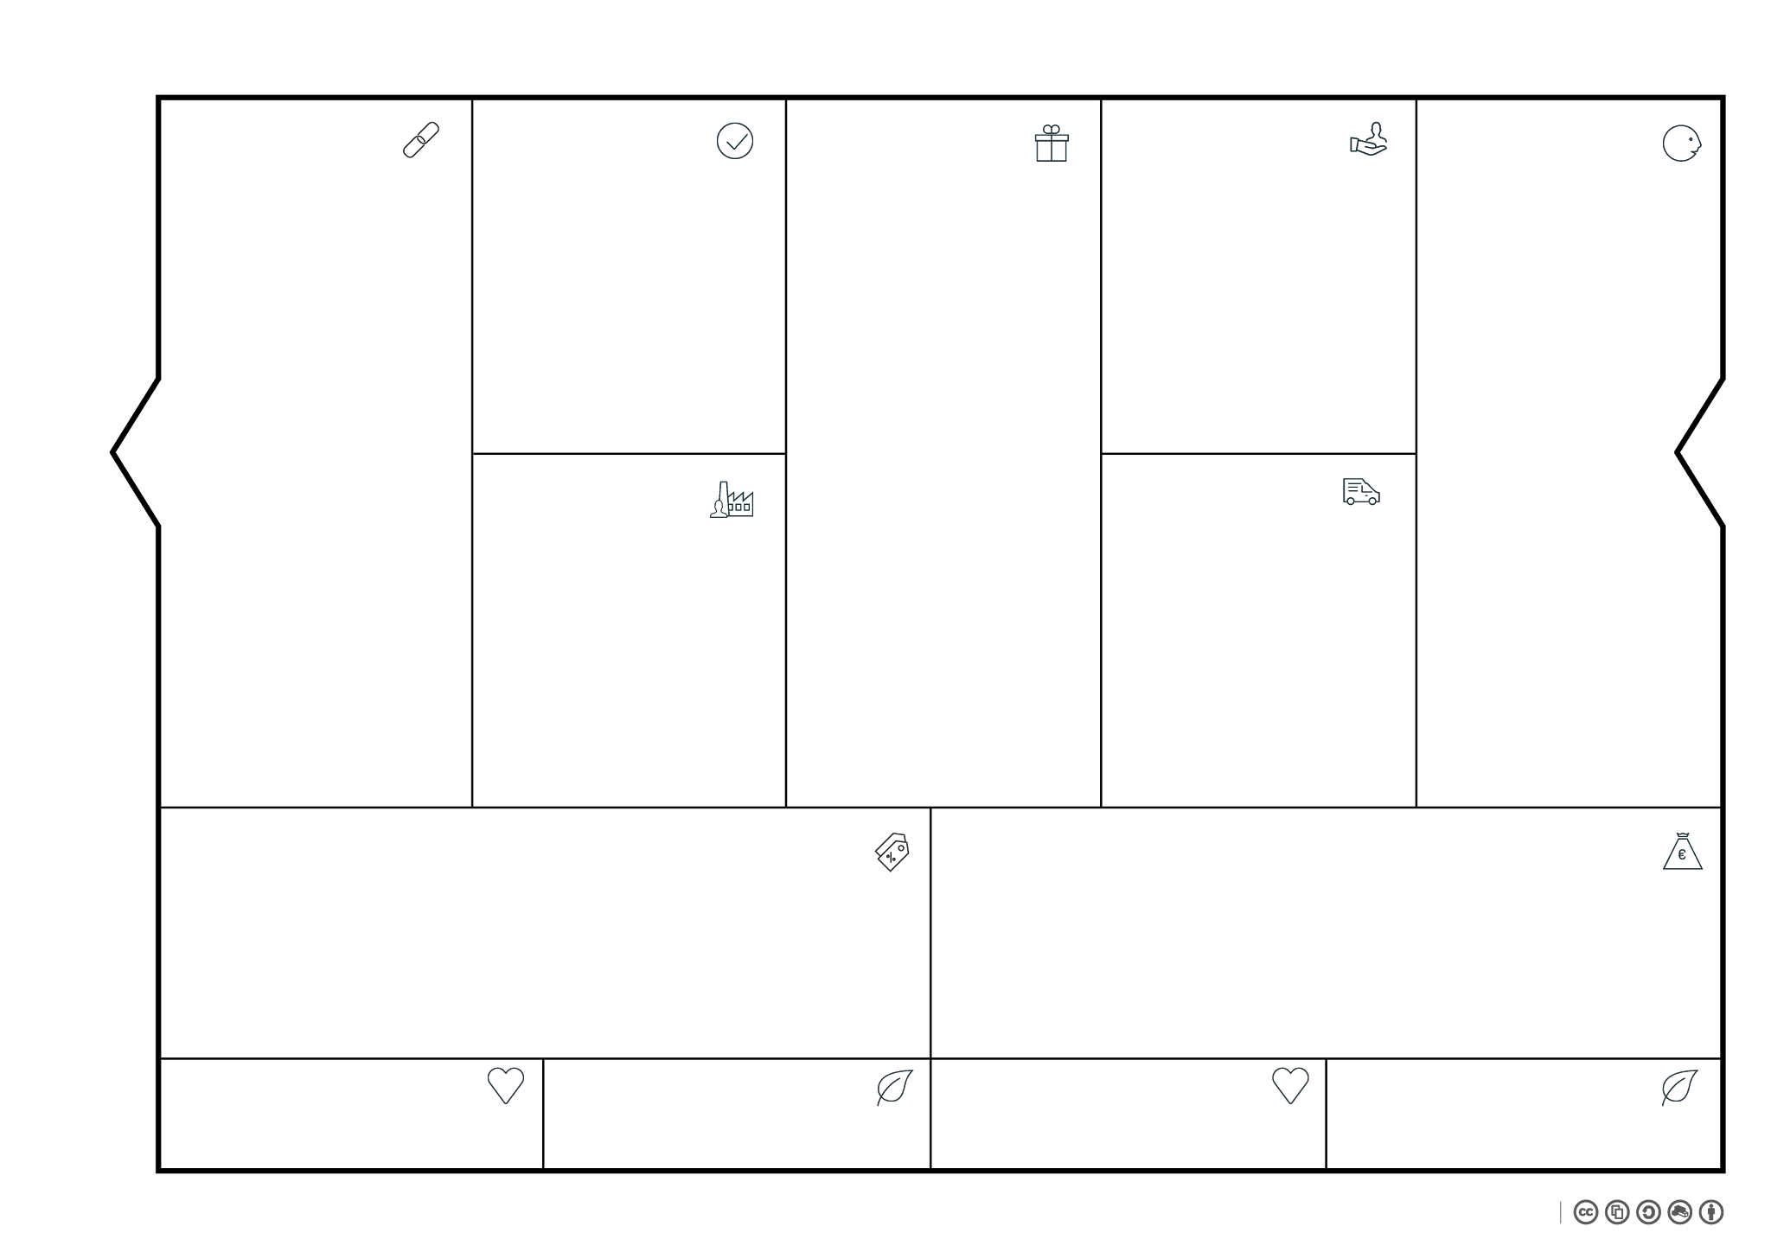
Who are your most important partners? Within the BMC we refer to Partners when you give them something (OUT), whether it be money, time, resources or anything else of value. Key Partners are partners which can’t be interchanged by somebody delivering the same service or resource. If they are interchangeable we call them Partners and you still can mention them here but they won’t have priority.
Of course the best partnerships should result in value for both parties. Ask yourself: What’s in it for them? Which Resources could they bring in and which Activities are they executing? How did you formalized this partnership?
Tip: If somebody you consider a partner pays you directly something of substantial value they are either considered a Customer within the Business Model Canvas (IN) or both a Partner and a Customer.
What do you need to do to realize your Value Proposition (verbs)?
To which of the following 3 categories do these Activities belong?
- Production
- Problem solving
- Networking
Describe for each Customer Segment both the product/service that you (the company or project) deliver to your customers and the value this is providing for them.
Which of your customers problems are you helping to solve? And how does this compare to what your competitors offer?
Which different qualitative and quantitative elements of the Value Proposition can you distinguish.
What is the price of one Value Proposition?
What type of Relationship does each of your Customer Segments expect to have with you?
Think off: personal, long term, self-service, community-based and co-creation.
Within the BMC we refer to Customers when they give you something (IN), whether it be money, time, resources or anything else of substantial value.
Who are your most important Customers? Are they consumers (B2C) or businesses (B2B)? Do you need to Segment your market?
Which Customer Segments do you serve? How many individuals
are there within each Segment?
Is your customer also the
end-user of the product?
Tip: whether someone is a customer, partner, team member, etc. can change during the lifetime of your BMC.
Tip: do not confuse the customers of your customers with your customers! Work out a value chain map if you want to see how many BM’s are needed to reach your intended end-user.
Which Key Resources do you need in order to realize your Value Proposition (and the Customer Relationships & Channels) and which from those come from partners?
Think off: computers, IP, knowledge, team members, employees, financial means etc.
How will you ensure your most important key-resource: the team will stay committed, focussed, motivated?
Through which Channels do your reach your Customer Segments?
Think off: all that is needed to make awareness, purchase, delivery and after-sales of your Value Proposition possible.
What are your most important Costs (of this specific BM)?
This is a sum of the Costs of your Value Proposition, Channels, Customer Relationships, Key Resources and Key Activities.
Tip: make a pie chart off all these Costs.
What are your most important Revenue Streams (of this specific BM)? Are these one-time or recurring incomes? If you are dealing with several Customer Segments you will most likely have a different Revenue Stream for every Customer Segment.
Tip: you could use the price your Customers are currently paying for an alternative solution to help you estimate what your customers would be willing to pay for your Value Proposition.
Like jealousy, loss of employment, health issues and abuse of power.
Like CO2 exhaustion, pollution and loss of biodiversity.
Like creating employment, fighting poverty and transferring knowledge.
Like greening an area, protection wildlife and upcycling waste.

Slide 4
Lasser cutter
Money to start up (bank)
Maker (complete al the peaces together)
Other companies that sells lamps
Transport
Sells
Produces
Mount / assemble
Reuse full product from individual pieces
There is contact in the store to sell theme the lamps and show them.
Sell the lamps to other company like ikea. Then there will only be contact to sell and transport them.
The customer can reuse this product over and over again while it has a different look. So if you are done with the look of your lamp you make a other lamp out of it. This is possible because of the connections between the pieces.
Students group 3
Create a store and show there your designs and make the atmosphere right to sell them.
Our most customers are the customers and not business.
Business can be interessting, but the influece to other customers is less.
Look for other companies that sell lamps and contact them through linked-in or other kind of digital communication.
Advertising the product
€ 100,- per month
€ 1200,- per year
Productie
€ 22,- per lamp
= 5800 * 22 = €127.600,-
There is one moment when there came money in, namely by selling the product. This money will be placed on the bank account of the company through IDEAL payment
€ 30,00,-
Transport
€ 3,50 per lamp
= 5800 * 3,50 = €20.300,-
= €149.100 per year
= €24.900 per year
= €174.000 per year
The look is less modern and fresh
Transport with CO²-emission
Create a lamp that customers can change by themselve
Use recycled products
Some money form out the sales while be use for planting new trees to compensate the CO²-emission. The rest will be invest to improve the products over and over again.

